Slide 1

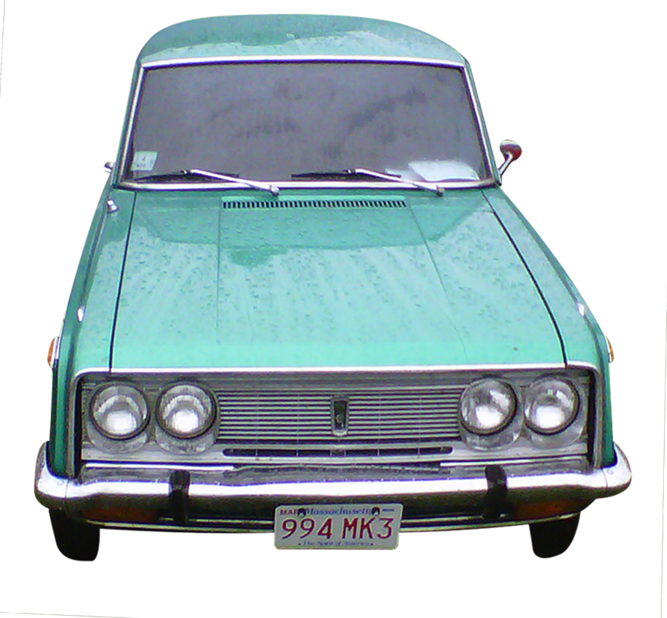
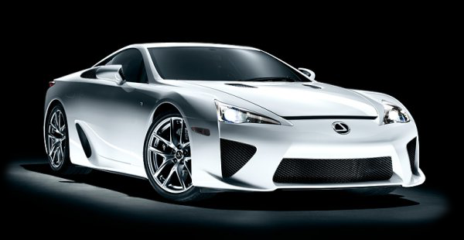

Vintage collector car show to benefit the fund for Boston parks & recreation
September 22, 2013
Boston common

Slide 2
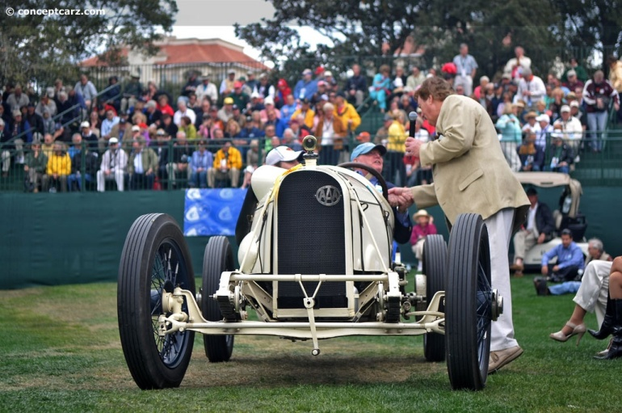
Inaugural event description
09.23.12 was a smash hit!
Our “Invitation Only” event attracted collectors such as Joe Freeman with his 1915 Duisenberg and many other rare cars totally over $35 million dollars worth of steel on the field!
Over 500 VIPs and 10,000 enthusiasts attended.
Speaker unveiling of the 1915 Duisenberg.

Slide 3
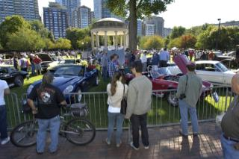
Some inaugural sponsors
Admirals Bank
W Residences
Copley Motorcars
Northeast Insurance
Racemaker Press
Cadillac, Chevrolet, Ford, Toyota, Mitsubishi, Nissan, BMW
Attendees checking out the classic cars.

Slide 4
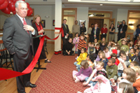
mission
5 years in the planning
Free for the general public/paid VIPs
An upscale event in Downtown Boston
Sponsorship from national car manufacturers, local car dealers & merchants
Presentation of the Mayor’s Cup
“To present a unique motorsports event to showcase the City of Boston.”

Slide 5
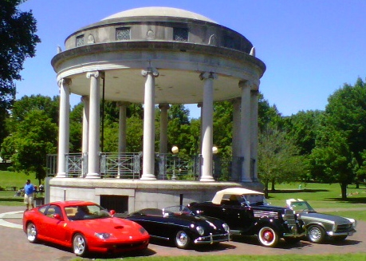
Location
Centered around the Parkman Bandstand, now celebrating its 100th birthday.
Its expanses and internal roadways are ideal for logistical purposes and public viewing.
The underground garage provides extensive public parking and car storage
Backdrop: Autumn in New England
THE BOSTON COMMON

Slide 6
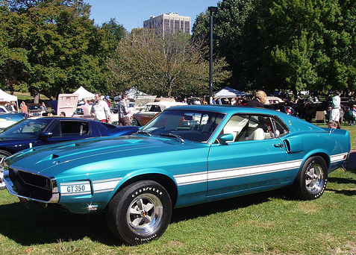
WHY A CLASSIC CAR SHOW?
More upscale than golf
Birds of a feather flock together
Great ways to thank best customers/ Attract new ones
More VIP assets for first sponsor commitments
Ability to help shape the event!
1969 Mustang GT350

Slide 7
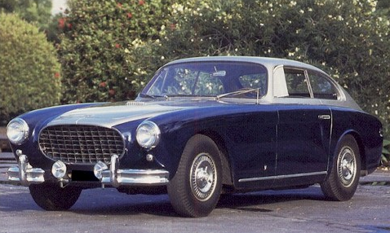
Sample of 3 winning cars
1952 Cunningham C-3

Slide 8
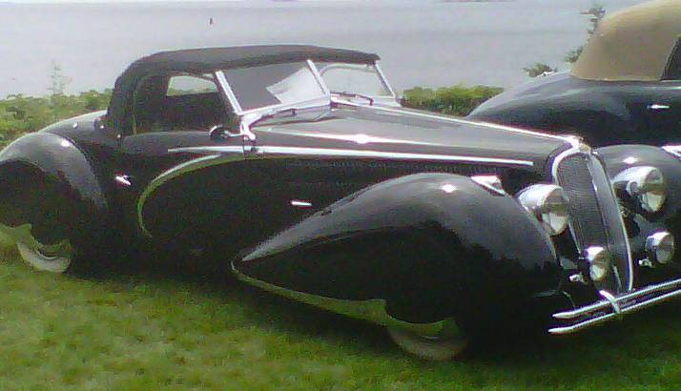
Sample of 3 winning cars
1948 Delahaye

Slide 9
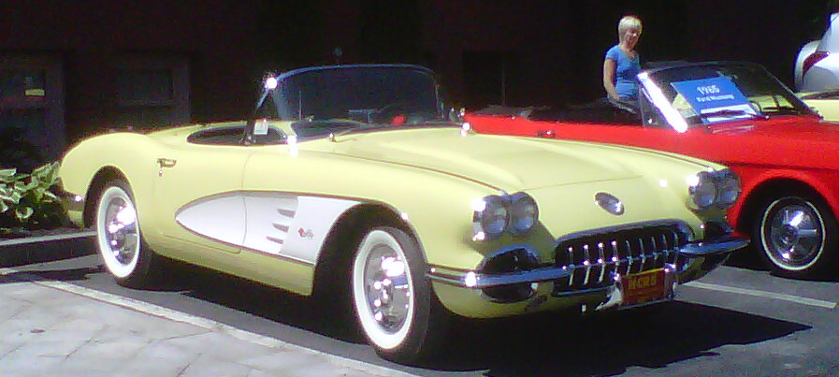
Sample of 3 winning cars
1957 Corvette

Slide 10
2013 additions
Featured Asian import sponsor for $50,000 (10 Cars)
Include Super car, Alt Fuel, etc.
VIP tickets, first pick of field location!
Pop-up car displays all over Boston in September
Ride & drive events (Ritz Hotel & Condos)
Saturday night gala at the Ritz-Carlton Hotel
Glossy program book
Possible Wall Street Journal Insert
Day of show banners, PA announcements
Only $5,000 per car

Slide 11
Can we count on your support?
September 22, 2013
Boston common

